Slide 1
Mini Project on
Text to speech convertor using Python
By
Aishwarya Naik -19UET025 Aparna Ringane -19UET038 Sakshi Rokade – 19UET039
Under Guidance of Prof. P. C . Dhanawade.

Slide 2
About project
In this Python project, we have build a GUI-based text to speech converter using python Tkinter, pyttsx3 modules. It is an intermediate-level python project that is used on a daily basis by some people and apply it in real life.

Slide 3
About Text to Speech (TTS) Converters
Text to speech converters convert text into speech using various algorithms. They have multiple applications and are especially useful when you have a sore throat. Generally, python Text to speech converters operate via CLI only if you have an active internet connection, but for this project, we will create a GUI python Text to speech converter which you can operate from your computer offline as well.

Slide 4
Project Prerequisites:
To build this project, we will need the following libraries:
Tkinter – To create a GUI for the project.
pyttsx3 – To convert text to speech; it will be used as TTS Conversion engine.
Although the Tkinter library comes pre-installed with Python, the pyttsx3 modules do not.
To install these libraries, you need to run the following command
pip install pyttsx3

Slide 5
Text to Speech Converter Project File Structure:
Here are the steps we need to execute to build this project:
Importing all the necessary modules and classes
Initialising window and placing all its components
Creating the backend speak() functions

Slide 6
1. Importing all the necessary modules and classes:
Explaination: After installing all the modules and libraries , they are imported to carry out further program.
These modules are imported by using import.

Slide 7
2. Initialising window and placing all its components:
Explanation:
Firstly, we need to create a main GUI window. To create that, we need to specify the following properties.
The Tk() class is used to initialize the python text to speech project window
The .title() method is used to specify a title of the window.
The .geometry() method is used to set the initial geometry, the initial dimensions of the window.

Slide 8
The .configure() method is used to configure certain properties of the window in the form of arguments of this method. Therefore, the bg attribute is used to give a background color to the window.
The .mainloop() methods of the Tk() class are used to put the window in a loop such that it does not get destroyed the moment it appears on the screen. Any code after the .mainloop() method regarding the GUI window will not be executed.
Now that the window is set, we will create and place all its components. The components in this window are the Label and the Button widgets.

Slide 9
The Label widget class is used to display static text on the window that cannot be selected or edited by the user in any way. You need to set the following attributes to create a Label widget:
The master attribute refers to the window it is associated with.
The text attribute specifies the text that will be present on the Label.
The font attribute is used to set the font type of the text displayed. It takes the arguments as a tuple, in the form of: (“font_family”, font_size[integer], ‘bold’/’italic’/both[optional])
The bg attribute gives a color to the widget.
Pack a widget in the parent widget. Use as options: expand=bool - expand widget if parent size grows fill=NONE or X or Y or BOTH - fill widget if widget grows padx=amount - add padding in x direction pady=amount - add padding in y direction side=TOP or BOTTOM or LEFT or RIGHT - where to add this widget.

Slide 10
The Button widget class is used to add a button to the window that performs a command when it is pressed. The attributes it takes to set itself are:
The master, text, bg, and font attributes are the same as in the Label class.
The command attribute is used to define the function that the button will execute when it is pressed. Generally, the command attribute sets a function without arguments.

Slide 11
3. Creating the backend speak() functions:
Explanation:
This is the step where we make use of the pyttsx3.
In the speak() function, we take the text of type str as an argument.
Firstly, we will initialise the pyttsx3 library and store it in the variable called engine.
Eventually, we will use the .say() method and provide it with the text taken as the argument to speak the said text.
We will also use the .runAndWait() method to tell the engine that the words spoken should not collide with any other task to be executed or is being executed.
If user has not entered text then we use the messagebox module function named as .showerror() to display pop up window which will show the message “Please enter the text”.

Slide 12
The final code:
from tkinter import *
from tkinter import messagebox
import pyttsx3
engine = pyttsx3.init()
win = Tk()
win.title("Write and Listen")
win.configure(bg="aqua")
win.geometry("420x200")

Slide 13
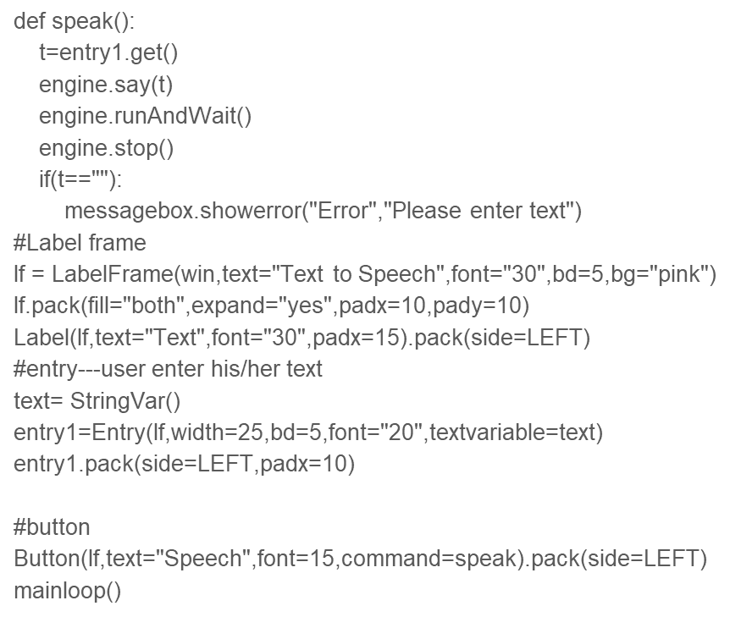

Slide 14
Advantages:
It helps to listen to class notes, textbook, and electronic text.
It avoids eyestrain from too much reading
It helps in preparation of speeches by gearing your work read aloud.
It helps seniors or thodehaving vision problem.
It can help in reading large paragraphs and offer range of different accents and voices.

Slide 15
Disadvantages:
Speech synthesis consumes more processing power as it is time consuming.
The resulting speech is less natural and emotionless. This is because it is impossible to get audio recordings of all possible words spoken in all possible emotions.
Pronunciation of words from written text is major concern.

Slide 16
THANK YOU.

